Slide 1
Week 10
CIS 347 / SOC 395
Stylometry

Slide 2
Hello, Stylometry
Stylometry is the study of the unique linguistic styles and writing behaviors of individuals in order to determine authorship. Its underlying assumption is that an author displays distinctive writing habits, which are exhibited in such features as the author's core vocabulary usage, sentence complexity and phraseology.
The goal: Authorship attribution. Which is important when identities can be adopted/obfuscated to avoid detection or Astroturf.

Slide 3
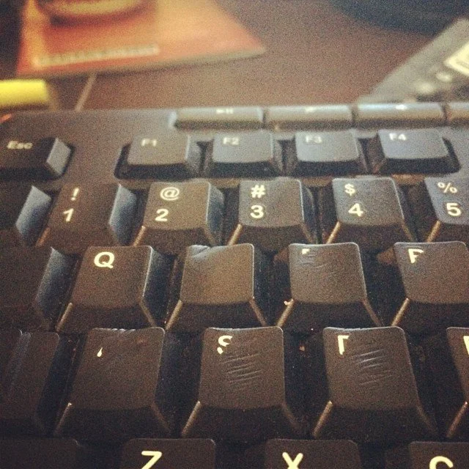
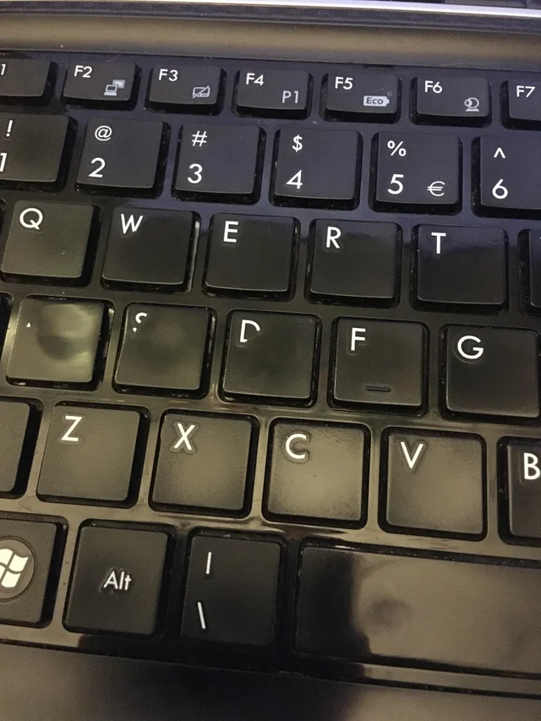
Biometrics
Typing
Speed (WPM)
Accuracy (errors, or correction keystrokes by percentage)
Typing habits (key preference)
Input device preference
Flight time in navigation / keystrokes
Commands per minute

Slide 4
Hello, Stylometry
Before we even get started with this, the FAQ. The efficacy of stylometry depends on a number of factors.
The more distinctive an author, the easier.
The more source material to analyze, the more confident the results. A single text message? Only a few unstable inferences could be made. Several novels? Pretty solid analysis.
The purpose of stylometry is primarily disambiguation. The individual characteristics of authorship (not a particular bit of text)
Stylometry is NOT offender profiling – it is case linkage analysis (CLA). The difference is one is an inference about behavior, the other is determining statistical similarities between data.

Slide 5
Stylometry Counter-Forensics
Yes, it is possible to frustrate stylometry if the author mindfully identifies and alters their patterns, but again – the more source material to work with the more difficult it is to eliminate any trace of identity.
The techniques here go from crude (Google Translate) to more sophisticated (deliberate) with varying degrees of success.

Slide 6
Google Translate Trick
Original -> Latin
No one will ever figure out I typed this.
No one will know I wrote this.
Latin -> Italian
Italian -> Spanish
Spanish -> English
But nobody has ever seen this kind of understanding.
But I know this.
Original -> Spanish -> English
Nobody will notice that I write this.
Nobody will know that I wrote this.

Slide 7
Case Linkage Analysis
The consensus is that yes – it does work, and applies to a broad number of crimes, having been used successfully in the cases of serial burglary, arson, homicide, and many others.
Why CLA? Because it’s an alternative to the traditional way of doing this – like victim reports, which are often inaccurate. Crimes are traumatic. Trauma can distort memories.

Slide 8
Case Linkage Analysis
Methodology
Separate behaviors into domains
Calculation a similarity coefficient (a coarse measure of similarity between crimes.)
Input into logistic regression model
Determine optional combination of domains
Receiver Operating Characteristic (ROC) curves (a measure of predictive accuracy or a way of estimating false positives.)

Slide 9
Case Linkage Analysis
Example: Two burglaries; Case A and Case B
We want to find out if the same offender is responsible for both crimes.
We first define a dichotomous dependent variable.
Y/N “Are these two crimes linked?”
Which behavioral domains best apply to answer this question? These are independent variables. In this case:
Entry behaviors – MO for entry (method, tools used, time of day, etc.)
Property behaviors – What was taken, any damage, etc.
Turn these independent dichotomous by turning them into Y/N questions:
“What a screwdriver used?”
“Was a window open?”
Was anyone home at the time?”

Slide 10
Case Linkage Analysis
Example: Two burglaries; Case A and Case B
Then we apply the similarity coefficient – Jaccard’s is the standard (though coarse) since Tonkin, et al 2008.
X= count of behaviors present in both cases.
Y= count of behaviors present in A but not B
Z= count of behaviors in B but not A
1 = perfect similarity, 0 = perfect dissimilarity
Of course, this all assumes all evidence was discovered & recorded, and does not consider “joint non-occurrences” aka. things that didn’t occur in either cases.
J = x / (x+y+z)

Slide 11
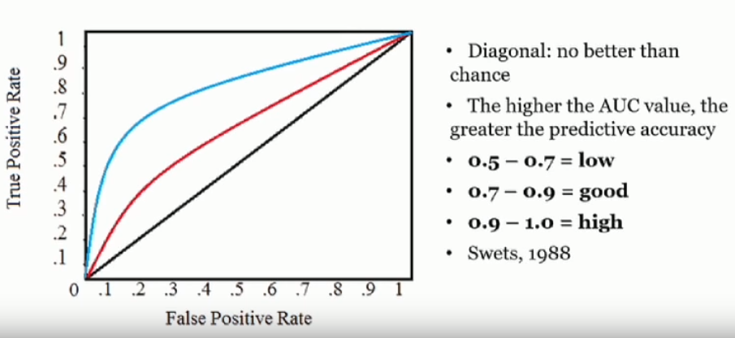
Case Linkage Analysis
Example: Two burglaries; Case A and Case B
Once you have your coefficients you can put them into a logistic regression model for predictive analysis. You see these all the time – To what extent does a given factor contribute to an outcome
To what extent does smoking contribute to heart attack?, etc.
In our case, do the behavior domains contribute to the offense.
Produces a p-value (probability of the null hypothesis being true, so the lower the better.)
Repeat for the other domains, run in combination to discount non-contributing factors.
This goes into the ROC curves – a graphic representation of the data. The graphs are usually x – probability of false positive against y – probability of true positive

Slide 12
Case Linkage Analysis
Yes, this applies to computer crimes as well. Matt Wixey conducted some research and presented it a DefCon this year. Recording volunteers on honeypots.
Hypothesis:
“Cyber attackers will exhibit consistent and distinctive behaviors whilst executing commands on compromised hosts, which will provide a statistically significant basis for distinguishing between linked and unlinked attack pairs.”
Behavior domains (40 behaviors each):
Navigation – moving through the filesystem
Enumeration – local recon
Exploitation – privesc and exfil attempted
3 metadata variables
Keystroke flight time in keystrokes
ms between commands
Backspaces as percentage of total keystrokes (typing accuracy)

Slide 13
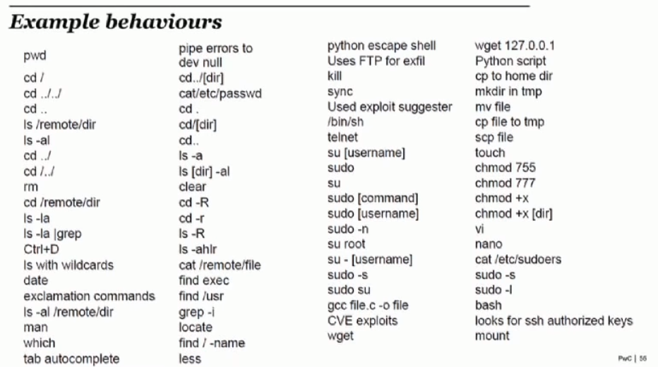
Case Linkage Analysis
Yes, this applies to computer crimes as well. Matt Wixey conducted some research and presented it a DefCon this year. Recording volunteers on honeypots.
Hypothesis:
“Cyber attackers will exhibit consistent and distinctive behaviors whilst executing commands on compromised hosts, which will provide a statistically significant basis for distinguishing between linked and unlinked attack pairs.”
Behavior domains (40 behaviors each):
Navigation – moving through the filesystem
Enumeration – local recon
Exploitation – privesc and exfil attempted
3 metadata variables
Keystroke flight time in keystrokes
ms between commands
Backspaces as percentage of total keystrokes (typing accuracy)

Slide 14
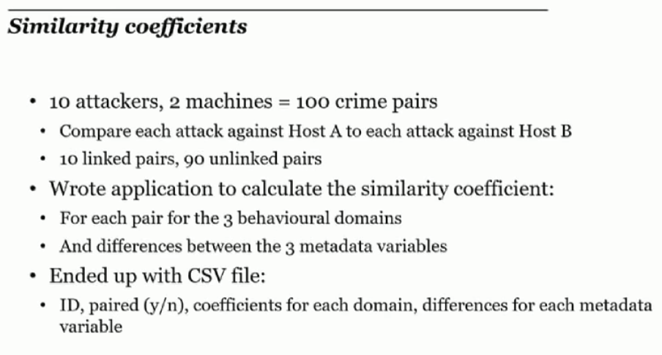
Case Linkage Analysis
Yes, this applies to computer crimes as well. Matt Wixey conducted some research and presented it a DefCon this year. Recording volunteers on honeypots.
Hypothesis:
“Cyber attackers will exhibit consistent and distinctive behaviors whilst executing commands on compromised hosts, which will provide a statistically significant basis for distinguishing between linked and unlinked attack pairs.”
Behavior domains (40 behaviors each):
Navigation – moving through the filesystem
Enumeration – local recon
Exploitation – privesc and exfil attempted
3 metadata variables
Keystroke flight time in keystrokes
ms between commands
Backspaces as percentage of total keystrokes (typing accuracy)

Slide 15
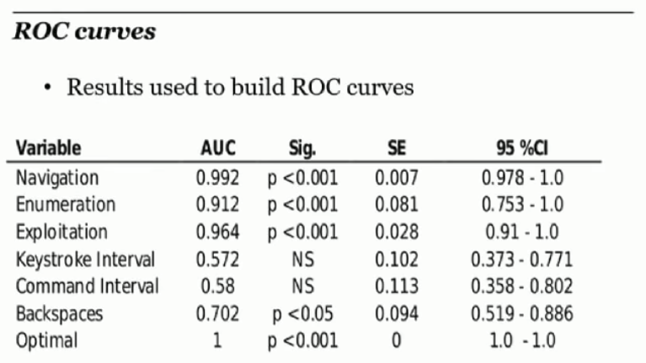
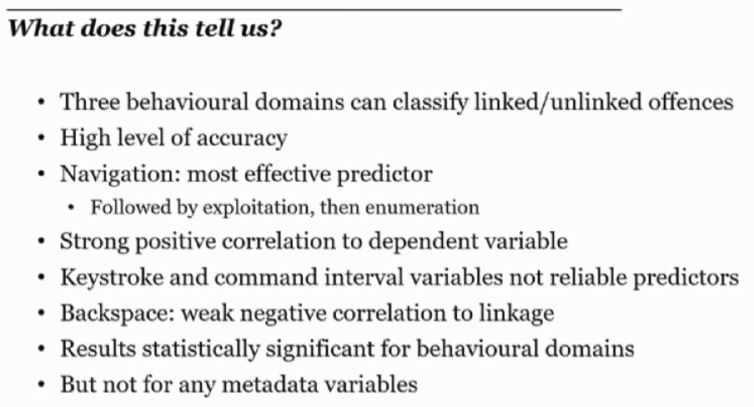
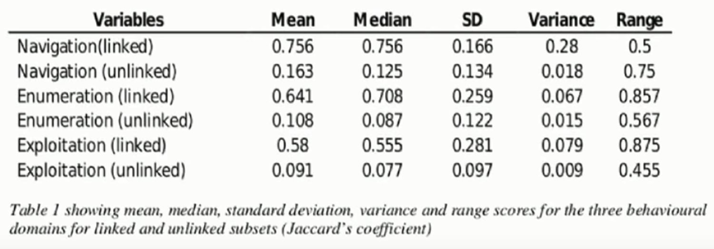

Slide 16
Case Linkage Analysis
Final notes on CLA:
Some offenses are less suitable to this process than others.
Offenses involving victim interaction likely to differ more, which is why this works very well for computer crimes.
Some offenders are more distinctive than others
Some behaviors are less consistent than others
For example, the property stolen in a burglary. The offender doesn’t control that.
MO is learned behavior, and offenders develop and refine their MO over the course of their criminal career.
Offenders will change behavior in response to events or in response to strain.

Slide 17
Phraseology
A mode of expression, especially one characteristic of a particular speaker or writer.
Word Choice
Connotation
Implication
Rare words
Function Words
Jargon / Slang

Slide 18
Hello, Stylometry
Digital forensics has less to go on than a physical crime scene.
There may still be clues of typology or whether the perpetrator is organized or disorganized, but often the only behaviors to observe are based in text and habit.
While it might not be entirely possible to construct a full profile from this, it can often be very revealing of a personal psychological traits.

Slide 19
Hello, Stylometry
Word choice. It can be assumed that a person with a more extensive vocabulary is better educated.
True, there is definitely a correlation, but the words we hold in our personal lexicon are more of a reflection of where we’ve been, what we identify with, and what we like – and from THERE comes the connection between education and vocabulary.
In short – Using big words doesn’t mean someone is intelligent. It is merely suggestive of their exposure to such words though (presumably) academic means. Age, for example, is also a positive correlate with lexicon.

Slide 20
Hello, Stylometry
Tier 1 – Basic vocabulary. Common words used everyday by everyone. I.e. “I hate giving speeches.”
Tier 2 – High frequency vocabulary. Common words in adult conversations and literature. I.e. “I don’t enjoy public speaking. It makes me anxious.”
Tier 3 – Low frequency, context-specific vocabulary. Words that only appear in certain domains, such as academia or certain vocations. “My avoidant personality makes public speaking difficult.”
Tier 4 – Low frequency, archaic or underutilized vocabulary. Includes sesquipedalian words / intelligentsia. Words that are rarely used in our time, or serve narrow purposes now served by other terms. I.e. “I am not garrulous or loquacious by nature, so I feel maladroit when presenting before an audience.”

Slide 21
The Digital Crime Scene
If you exclude proper nouns, multiword phrases (like “kick the bucket”), and derived words (like “helplessly,” from “help”)—the typical English-speaking American knows about 42,000 of these so-called “lemmas” by the age of 20. High scorers—those in the top 5%—know an average of 52,000 lemmas, whereas low scorers—those in the bottom 5%—know an average of 27,000.

Slide 22
The Digital Crime Scene
Text is about so much more than vocabulary, however. There are things like grammar and syntax that make language what it is and establish tone.
http://www.analyzewords.com/ is a site that looks up tweets to do a personality assessment.
The Internet is already not as anonymous as it used to be, and with this we can more easily establish usage across many sites.

Slide 23
Phraseology
Lexical Frequencies
Hapax Legomenon
This is a word that occurs only once within a context, either in the written record of an entire language, in the works of an author, or in a single text.
Idiolect / Stylistics
Cliché density
Emojis

Slide 24
Stylistic Features
Lexical Frequencies:
Number of sentences beginning with uppercase / lowercase
Number of words / sentences / paragraphs
Average word length
Average number of words per sentence / paragraph
Number and use of special characters !@#$%^&*, etc.
Use of commas, ellipsis, punctuations marks (multiple?)
Prefixing (However, Likewise, Therefore, etc.)
Filler words (like, well, you know, etc.)
Function words (the, to, but, and, etc.)

Slide 25
Connotation
Connotation is the meaning attached to a word beyond is raw definition.
“Billy is lazy.” vs. “Billy is weary.” vs. “Billy is lethargic.”
Connotation is partially reliant on lexicon – a subject may not be familiar with all of the synonyms for a word, and is not likely to consult a thesaurus before composing a message.
Connotation is, despite that, a way to infer emotion of the author.
“Adam Sandler should consider suicide”
“Adam Sandler is a talentless hack”

Slide 26
Ernest Hemingway, 1922
All armies are the same
Publicity is fame
Artillery makes the same old noise
Valor is an attribute of boys
Old soldiers have tired eyes
All soldiers hear the same old lies
Dead bodies have always drawn flies

Slide 27
Ernest Hemingway, 1922
All armies are the same
Publicity is fame
Artillery makes the same old noise
Valor is an attribute of boys
Old soldiers have tired eyes
All soldiers hear the same old lies
Dead bodies have always drawn flies

Slide 28
Stylometry Tech
There are a lot of tools out there for stylometric research.
Signature
JGAAP – Java Graphical Authorship Attribution Project
R Project – Requires R Studio and R-Stylo
Several online tools, like this one from AICBT
Writing your own.
We can also look to existing analysis datasets and assumptions, like CAPS – Cognitive-Affective Personality System, which shows human behavior is consistent, but distinctive.

Slide 29
Sample 1
There was no hope for him this time: it was the third stroke. Night after night I had passed the house (it was vacation time) and studied the lighted square of window: and night after night I had found it lighted in the same way, faintly and evenly. If he was dead, I thought, I would see the reflection of candles on the darkened blind for I knew that two candles must be set at the head of a corpse. He had often said to me: “I am not long for this world,” and I had thought his words idle. Now I knew they were true. Every night as I gazed up at the window I said softly to myself the word paralysis. It had always sounded strangely in my ears, like the word gnomon in the Euclid and the word simony in the Catechism. But now it sounded to me like the name of some maleficent and sinful being. It filled me with fear, and yet I longed to be nearer to it and to look upon its deadly work.

Slide 30
Where this Applies
This is important because studies of certain crimes, especially mass shootings, show that they are not the result of the offender suddenly “snapping” – it’s a long, slow build-up of frustration and strain that is released with an explosive criminal act.
1. The 63 active shooters examined in this study did not appear to be uniform in any way such that they could be readily identified prior to attacking based on demographics alone.
2. Active shooters take time to plan and prepare for the attack, with 77% of the subjects spending a week or longer planning their attack and 46% spending a week or longer actually preparing (procuring the means) for the attack.
3. A majority of active shooters obtained their firearms legally, with only very small percentages obtaining a firearm illegally.
4. The FBI could only verify that 25% of active shooters in the study had ever been diagnosed with a mental illness. Of those diagnosed, only three had been diagnosed with a psychotic disorder.
5. Active shooters were typically experiencing multiple stressors (an average of 3.6 separate stressors) in the year before they attacked.

Slide 31
Where this Applies
This is important because studies of certain crimes, especially mass shootings, show that they are not the result of the offender suddenly “snapping” – it’s a long, slow build-up of frustration and strain that is released with an explosive criminal act.
6. On average, each active shooter displayed 4 to 5 concerning behaviors over time that were observable to others around the shooter. The most frequently occurring concerning behaviors were related to the active shooter’s mental health, problematic interpersonal interactions, and leakage of violent intent.
7. For active shooters under age 18, school peers and teachers were more likely to observe concerning behaviors than family members. For active shooters 18 years old and over, spouses/domestic partners were the most likely to observe concerning behaviors.
8. When concerning behavior was observed by others, the most common response was to communicate directly to the active shooter (83%) or do nothing (54%). In 41% of the cases the concerning behavior was reported to law enforcement. Therefore, just because concerning behavior was recognized does not necessarily mean that it was reported to law enforcement.
9. In those cases where the active shooter’s primary grievance could be identified, the most common grievances were related to an adverse interpersonal or employment action against the shooter (49%).
10. In the majority of cases (64%) at least one of the victims was specifically targeted by the active shooter.

Slide 32
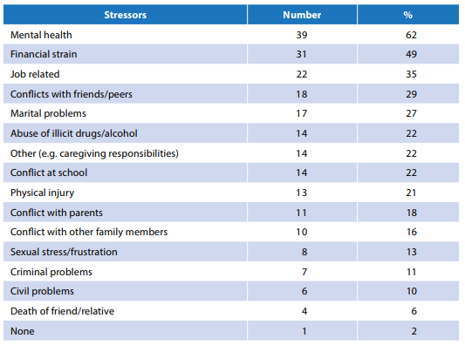
Where this Applies
This means that there may be indications weeks or months before an incident where warning signs may be identified.
On average, a shooter spends 1-2 months ramping up to the event.
Ramping up does not mean planning the attack and gathering materials – it means the strain is building, and likely has been long enough that the shooter does not need to go out and prepare much once the time comes.
Remember our talk on behavioral analysis – isolation means and increase in online activity, so we would likely see more messages from a subject in the prior prior to an incident.

Slide 33
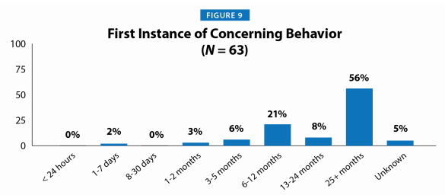
Where this Applies
Concerning Behavior | Number | %
Mental Health | 39 | 62
Interpersonal Interactions | 36 | 57
Leakage | 35 | 56
Quality of thinking / communication | 34 | 54
Work performance | 11 | 46
School performance | 5 | 42
Threats/confrontations | 22 | 35
Anger | 21 | 33
Physical aggression | 21 | 33
Risk-taking | 13 | 21
Firearm behavior | 13 | 21
Drug abuse | 12 | 18
Impulsivity | 7 | 11

